Slide 1
Logic tasks

Slide 2
Logic task goal
Do task in high level. Create maven or gradle project in parent + module structure.
Create solution as library in modules, that would be used in parent project.
All your task should be restful. For input data use POST, for retrieve data use GET.
All your inputs and results have to be saved into database (H2/MySQL(MariaDB)/PostgreSQL). Think before you start.
Use Postman to test your restful requests.
p.s.: Bonus if you will use API documentation. Most popular is Swagger. You can use simple springfox-swagger2 solution with Jersey

Slide 3
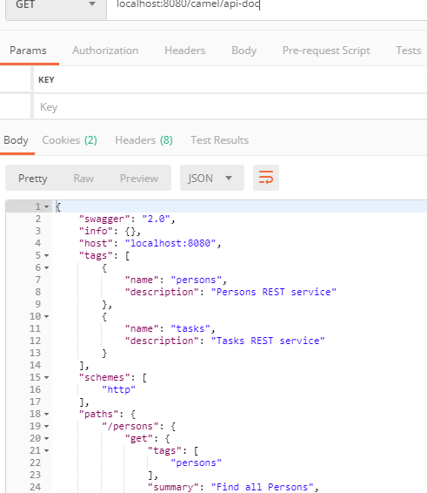
What is Postman?

Slide 4
Project Module 1: Logic task 1
You need to write a library to print duplicate characters from a given String, for example if String is "Java" then should print "a". Bonus points if your library is robust and handle different kinds of input e.g. String without duplicate, null or empty String etc. Bonus points if you also write unit tests for normal and edge cases.

Slide 5
Project Module 1: Logic task 2
You need to write a library to print all duplicate character and their count in Java. For example if given String is "Programming" then your library should get result g : 2 r : 2 m : 2

Slide 6
Project Module 1: Logic task 3
Using previous task, optimize your code smarter as you can. Previous tests have to work (possible small corrections).
Which code we can say as optimized? Lector will explain ☺

Slide 7
Project Module 2: Logic task 4
You need to write a library to check a String contains only numbers by using Regular expression in Java. You can use Java API but a solution without using Java API will be better.

Slide 8
Project Module 3: Logic task 5
Task has a easy recursive solution but thinks get really tricky when you ask yourself to solve this question without using recursion. You can use Stack though. Write a program to print all permutations of a String in Java, for example, the if input is "xyz" then it should print "xyz", "yzx", "zxy", "xzy", "yxz", "zyx"

Slide 9
Homework
What is Gang of Four (GOF)?
In 1994, four authors Erich Gamma, Richard Helm, Ralph Johnson and John Vlissides published a book titled Design Patterns - Elements of Reusable Object-Oriented Software which initiated the concept of Design Pattern in Software development.

Slide 10
Links to tasks
http://javarevisited.blogspot.lt/2015/01/top-20-string-coding-interview-question-programming-interview.html

